Slide 1


Slide 2
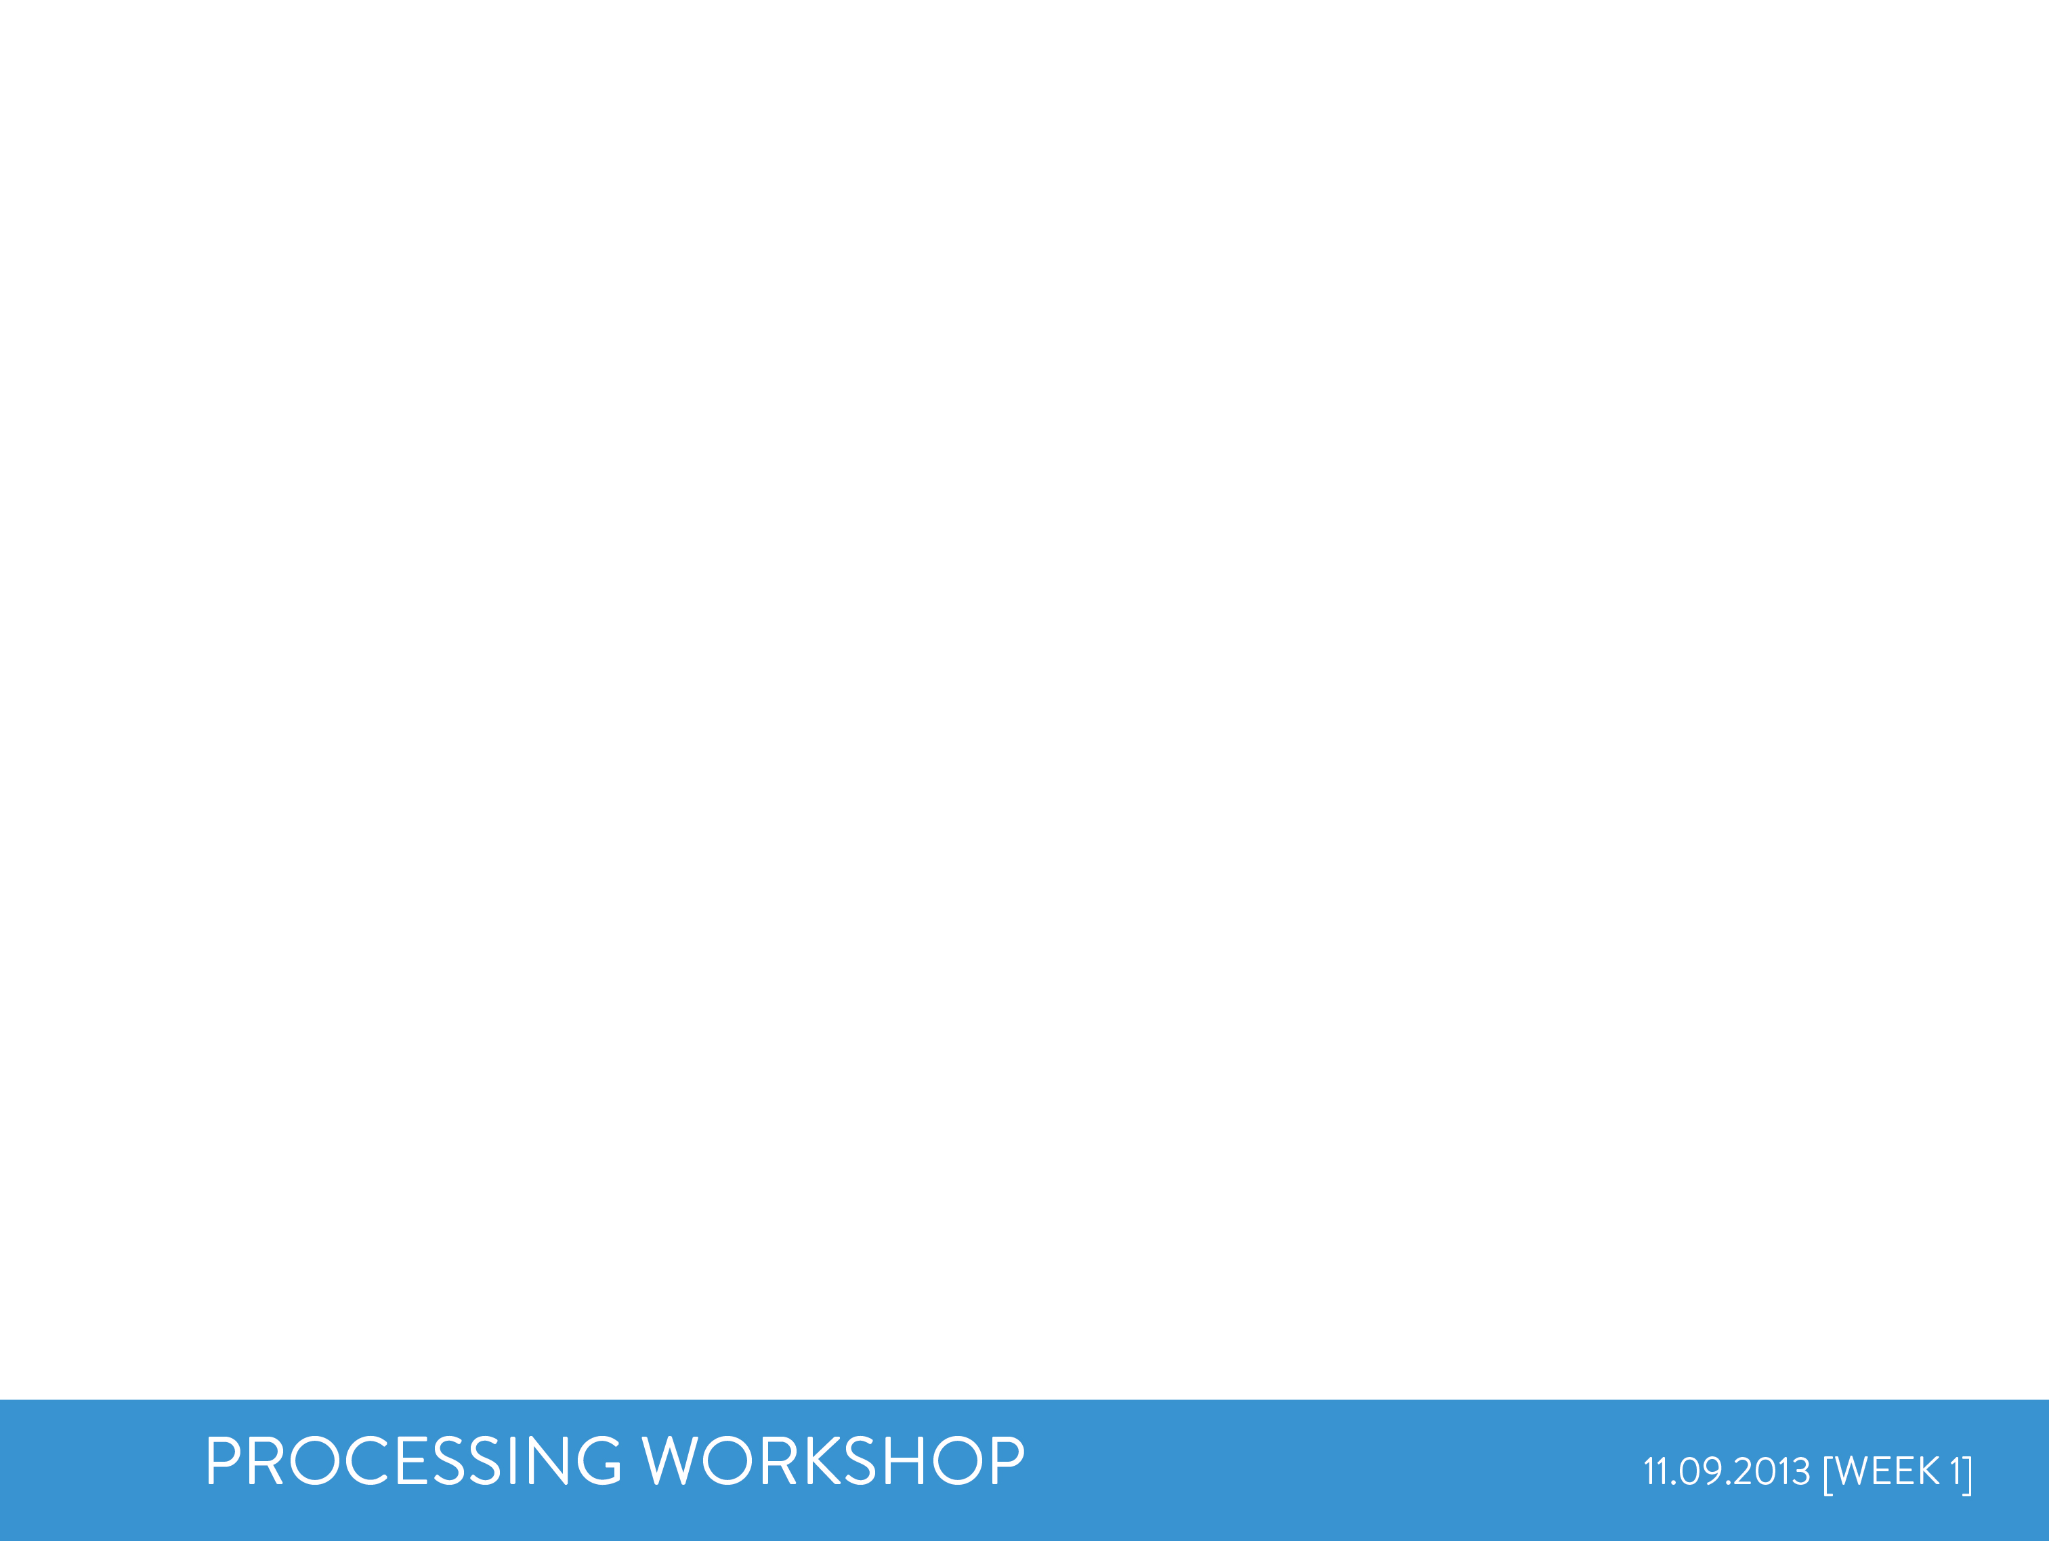
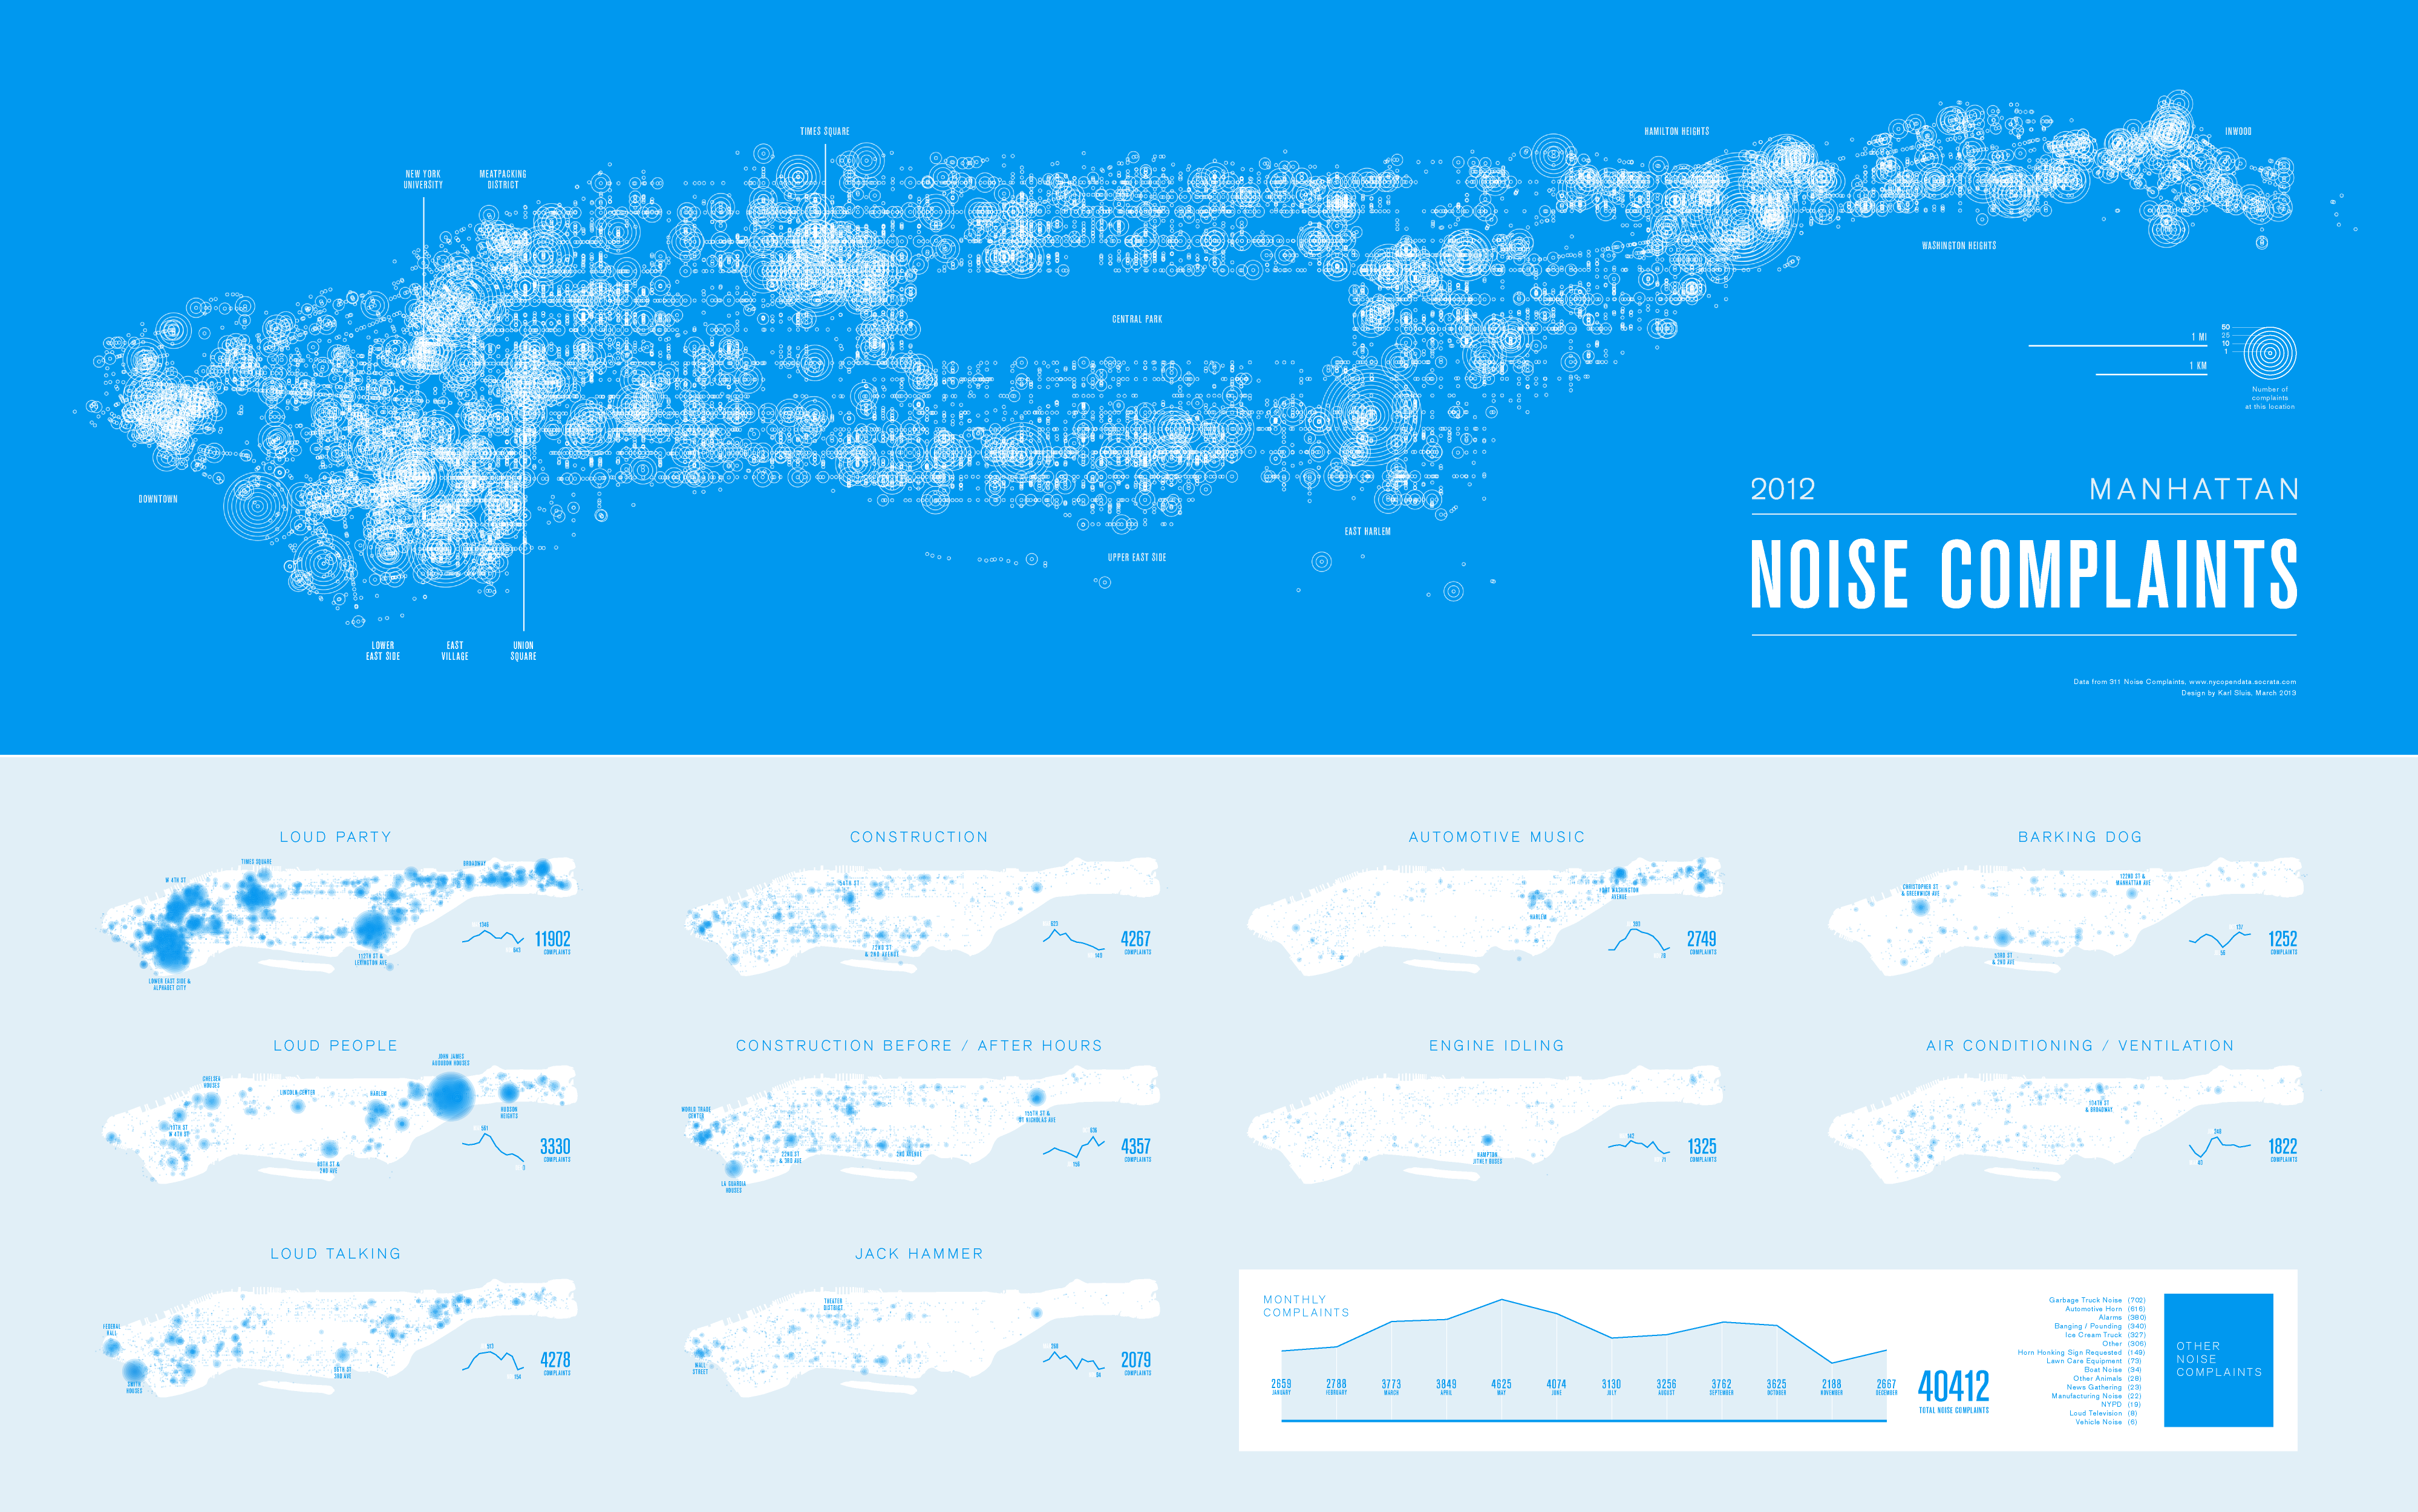
Notes:
USES- DATA RETENTION/access
USES- ALTERNATE REP TYPES
USES- LIVE UPDATE- JSON/API ACCESS
USES- INTERACTION/CALC/WRITE POTENTIALS

Slide 3
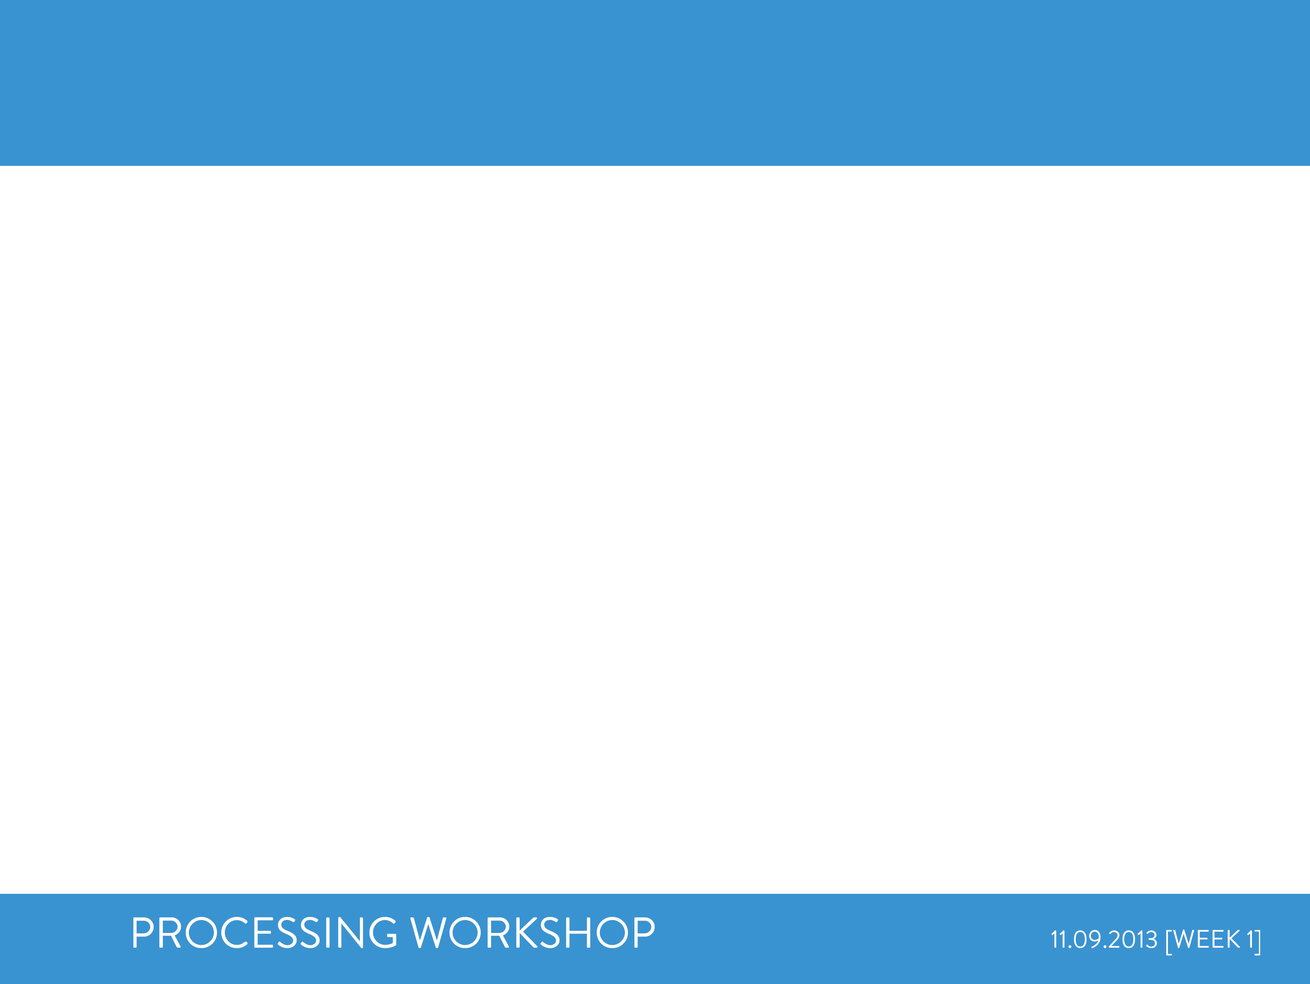
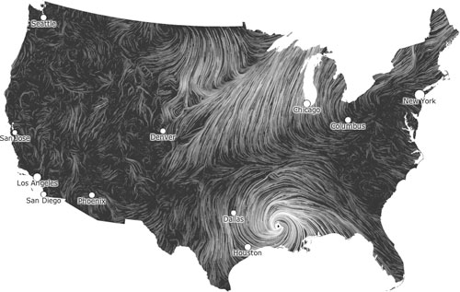
PLOTTING ENVIRONMENT
http://hint.fm/wind/

Slide 4
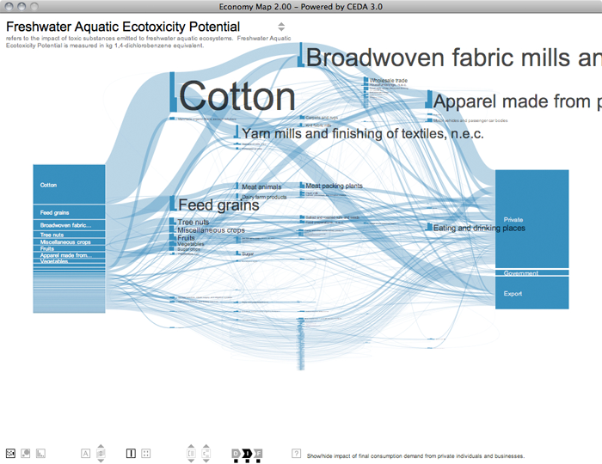
PLOTTING ENVIRONMENT
Economymap.org

Slide 5
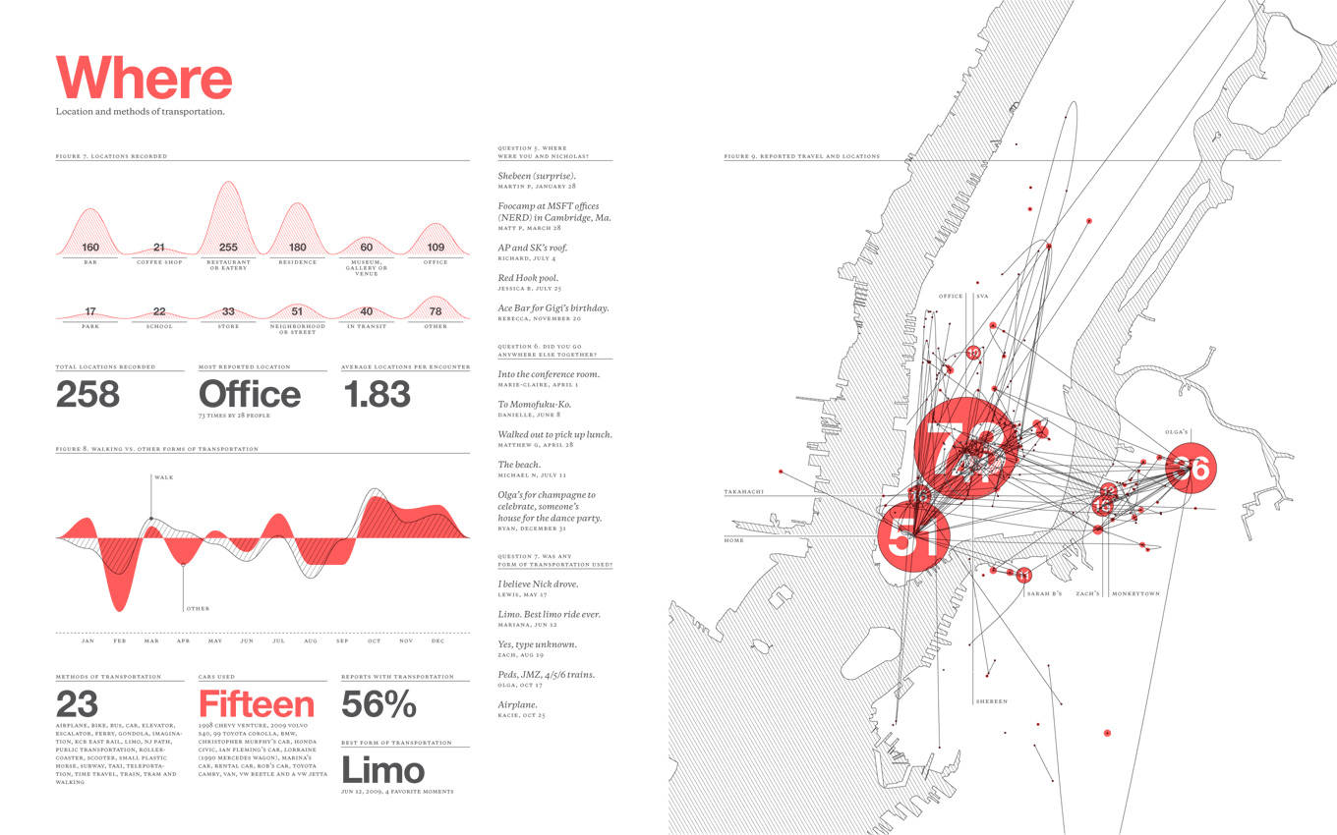
PLOTTING ENVIRONMENT
Feltron.com

Slide 6
WORKSHOP STRUCTURE
WK 1- BASIC PLOTTING
WK 2-INTERACTIONS, DASHBOARDS
WK 3-LIVE DATA

Slide 7
TODAY’S AGENDA
1-COMPUTATIONAL STRUCTURE (is familiar!)
2-processing as plotting ENVIRONMENT
break
3-sourcing DATA, thinking DATA-REP forms
4-CODING AN EXAMPLE together
break
5-SAME DATA, alternate views/forms

Slide 8
1_COMPUTATIONAL STRUCTURE

Slide 9
1_COMPUTATIONAL STRUCTURE
311 Noise:
geolocation
filtering
calculation
max/min values
complaint sums
temporal plots

Slide 10
1_sources/references
311 Noise:
geolocation
filtering
https://data.cityofnewyork.us/Social-Services/311/wpe2-h2i5
http://www.processing.org/reference

Slide 11
1_variables
311 Noise:
geolocation
filtering
Geolocation is merely filtering:
a) specifying columns to search
b) specifying rows to read values from
c) setting up VARIABLES to hold those values

Slide 12
1_variable types
Variables:
int
float
String
Char
Boolean
color
double (long float)
long (long int)
byte (serial info)
VARIABLES types:
int = integers (whole numbers= 0, 1, 2, 3, etc. )
float= floating decimals (numbers with decimal info= 1.235, 3.147, .06892)
String= string of characters (words or numbers to be read as words= hello, 10005)
char= character (single letter or key-strike= k)
Boolean= a boolean value of true or false (basic binary logic of computing off/on, 0/1, etc.)
color= color variables in rgb alpha (color as (255,0,0,100) which is r,g,b,alpha from 0-255)

Slide 13
1_variable definition
Variables:
int
float
String
Char
Boolean
color
double (long float)
long (long int)
byte (serial info)
VARIABLES definition (sample):
variable type + variable name = value;
int sum = 40412;
String sumTitle= “Total Noise Complaints”;
int x= -73.8833309977321;
variables nest and can be dynamically redefined to build complexity

Slide 14
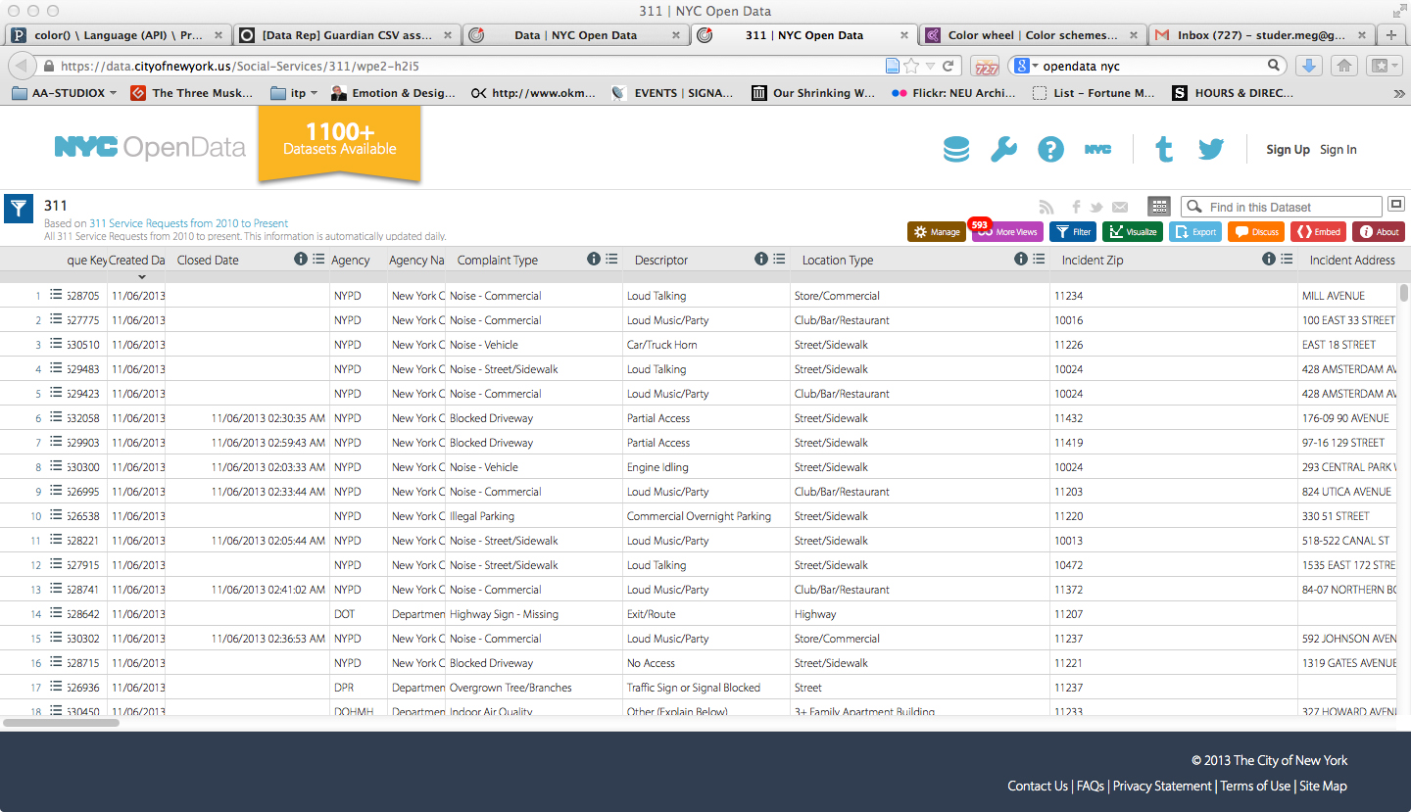
1_conditionals
311 Noise:
geolocation
filtering
In order to filter data for variables,
we specify conditions by asking questions with CONDITIONALS:
Does the column title read “Longitude”, if so…?
Is there a value for “Closed Date”, row 75, if so…?

Slide 15
1_conditional types
Conditionals:
if
else
else if
switch (cases, break)
…others
CONDITIONAL types (dominant use):
if = tests a statement (if statement is true (x is less than 6), do something)
else= covers false responses to ‘if’(statement is true (x is less than 6), do A, else do B)
else if= takes a false response and tests for another statement (if x, else if y, else z)
switch= chooses between cases (searches for parameter match)
and others…

Slide 16
1_OPERATORS
Conditionals:
if
else
else if
switch (cases, break)
…others
Operators:
>
=>
<
=<
==
=!
&&
||
!
To compare in CONDITIONALS, we need OPERATORS:
RELATIONAL
> great than < less than
=> equal to or great than =< equal to or less than
== is or equality =! Is not or inequality
LOGICAL
&& And || Or
! Not

Slide 17
1_STRUCTURE
Variables:
int
float
String
Char
Boolean
color
Conditionals:
if
else
else if
Operators:
>
=>
<
=<
==
=!
&&
||
!
To link CONDITIONALS, OPERATORS, and VARIABLES
we will need to use Processing’s syntax
(common examples, much more later as we code):
() (parentheses) mathematical use, brackets for variables and statements
, (comma) separates values of variables
/* */ (multiline comment) so you can leave notes in your code
// (comment) so you can leave notes in your code
; (semicolon) end of line
= (assign) set variables
{} (curly braces) encloses a block of code, such an the actions for conditionals

Slide 18
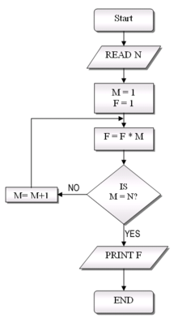
1_in action
VARIABLES, OPERATORS, & CONDITIONALS IN ACTION:
PSUEDO CODE SAMPLE
int x;
Boolean z;
color y;
//Other Code Here
If (x<=12 && z==true) {
color y=color (255,0,0);
} else {
color y=color (0,255,0);
}
//draw a shape of color y

Slide 19
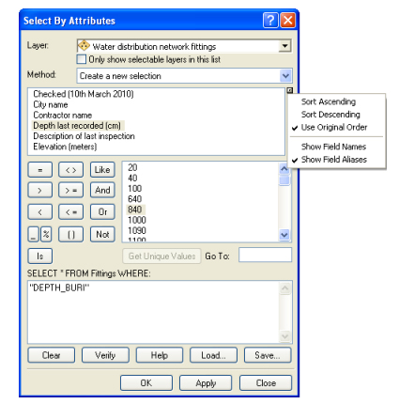
1_in action_gis
FAMILIAR EXAMPLE
PSUEDO CODE SAMPLE
int x;
Boolean z;
color y;
//Other Code Here
If (x<=12 && z==true) {
color y=color (255,0,0);
} else {
color y=color (0,255,0);
}
//draw a shape of color y

Slide 20
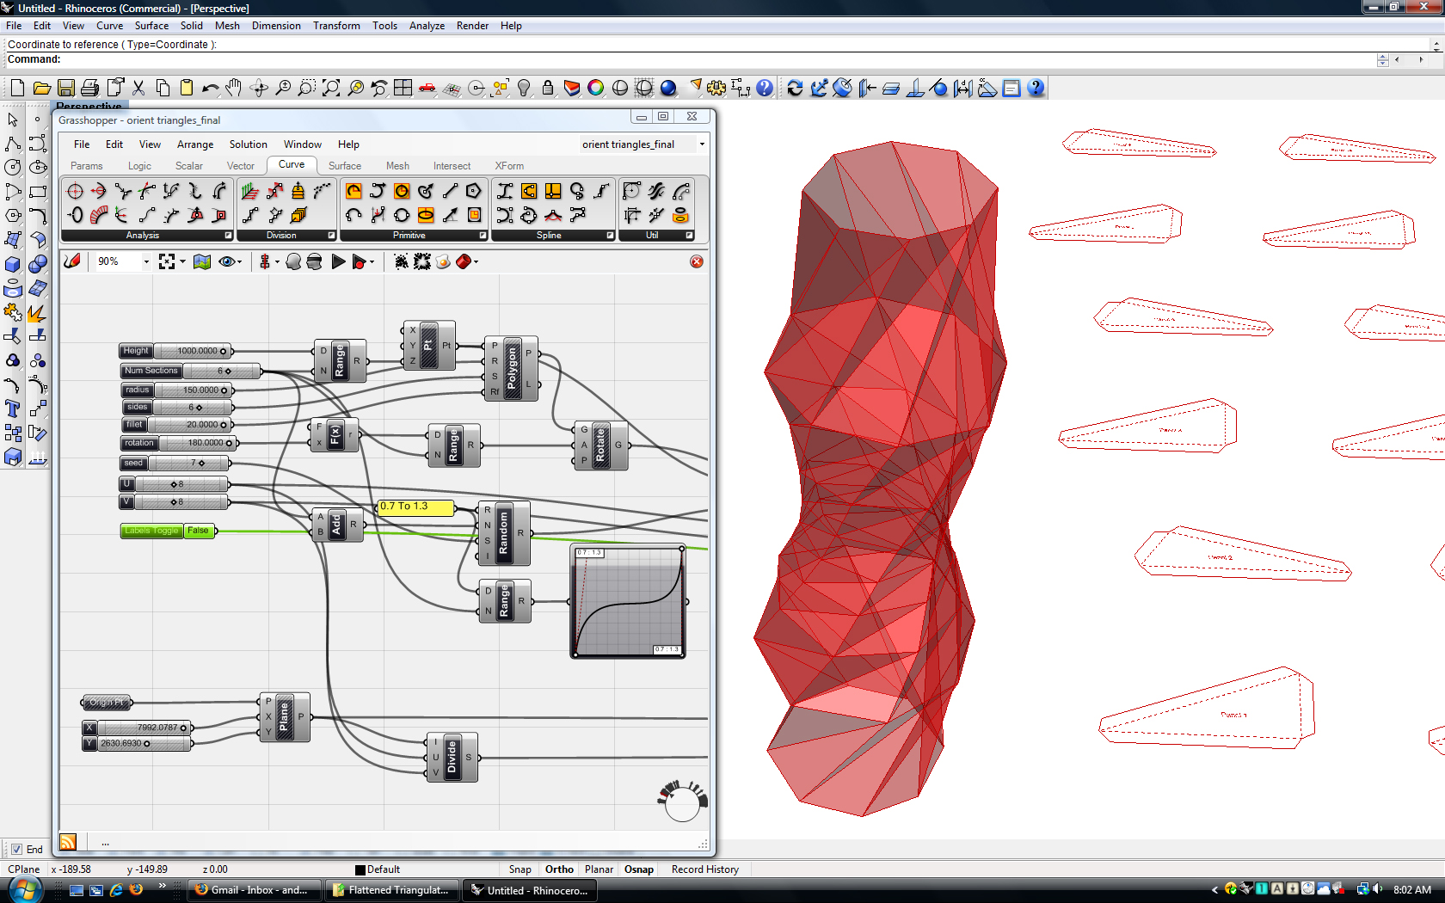
1_in action_rhino/grasshopper
FAMILIAR EXAMPLE
PSUEDO CODE SAMPLE
int x;
Boolean z;
color y;
//Other Code Here
If (x<=12 && z==true) {
color y=color (255,0,0);
} else {
color y=color (0,255,0);
}
//draw a shape of color y

Slide 21
1_CALCULATION/FUNCTIONS
311 Noise:
geolocation
filtering
calculation
max/min values
complaint sums
temporal plots

Slide 22
2_PLOTTING ENVIRONMENT

Slide 23
2_PLOTTING ENVIRONMENT
1-COMPUTATIONAL STRUCTURE (is familiar!)
2-processing as plotting ENVIRONMENT
break
3-sourcing DATA, thinking DATA-REP forms
4-CODING AN EXAMPLE together
break
5-SAME DATA, alternate views/forms

Slide 24
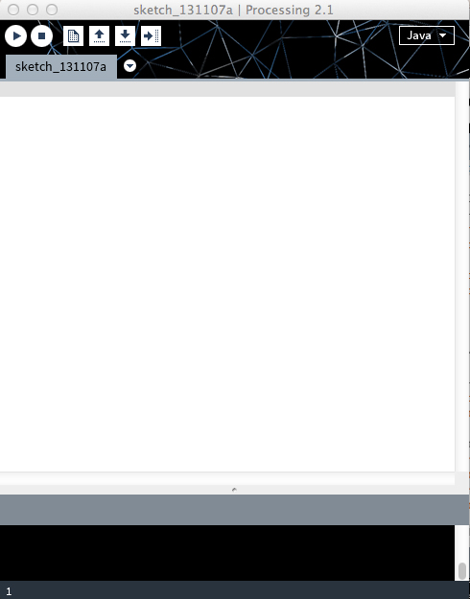
2_PLOTTING ENVIRONMENT
PROCESSING:
Open Processing
Interface
Menus/SubMenus
Sample1
Pde/Application
Static/Active
Sample2
Primitive Shapes
Display Parameters
Loops/Interactions
Sample3 [311 file]
Built-in Table Functions
File Import/Export

Slide 25
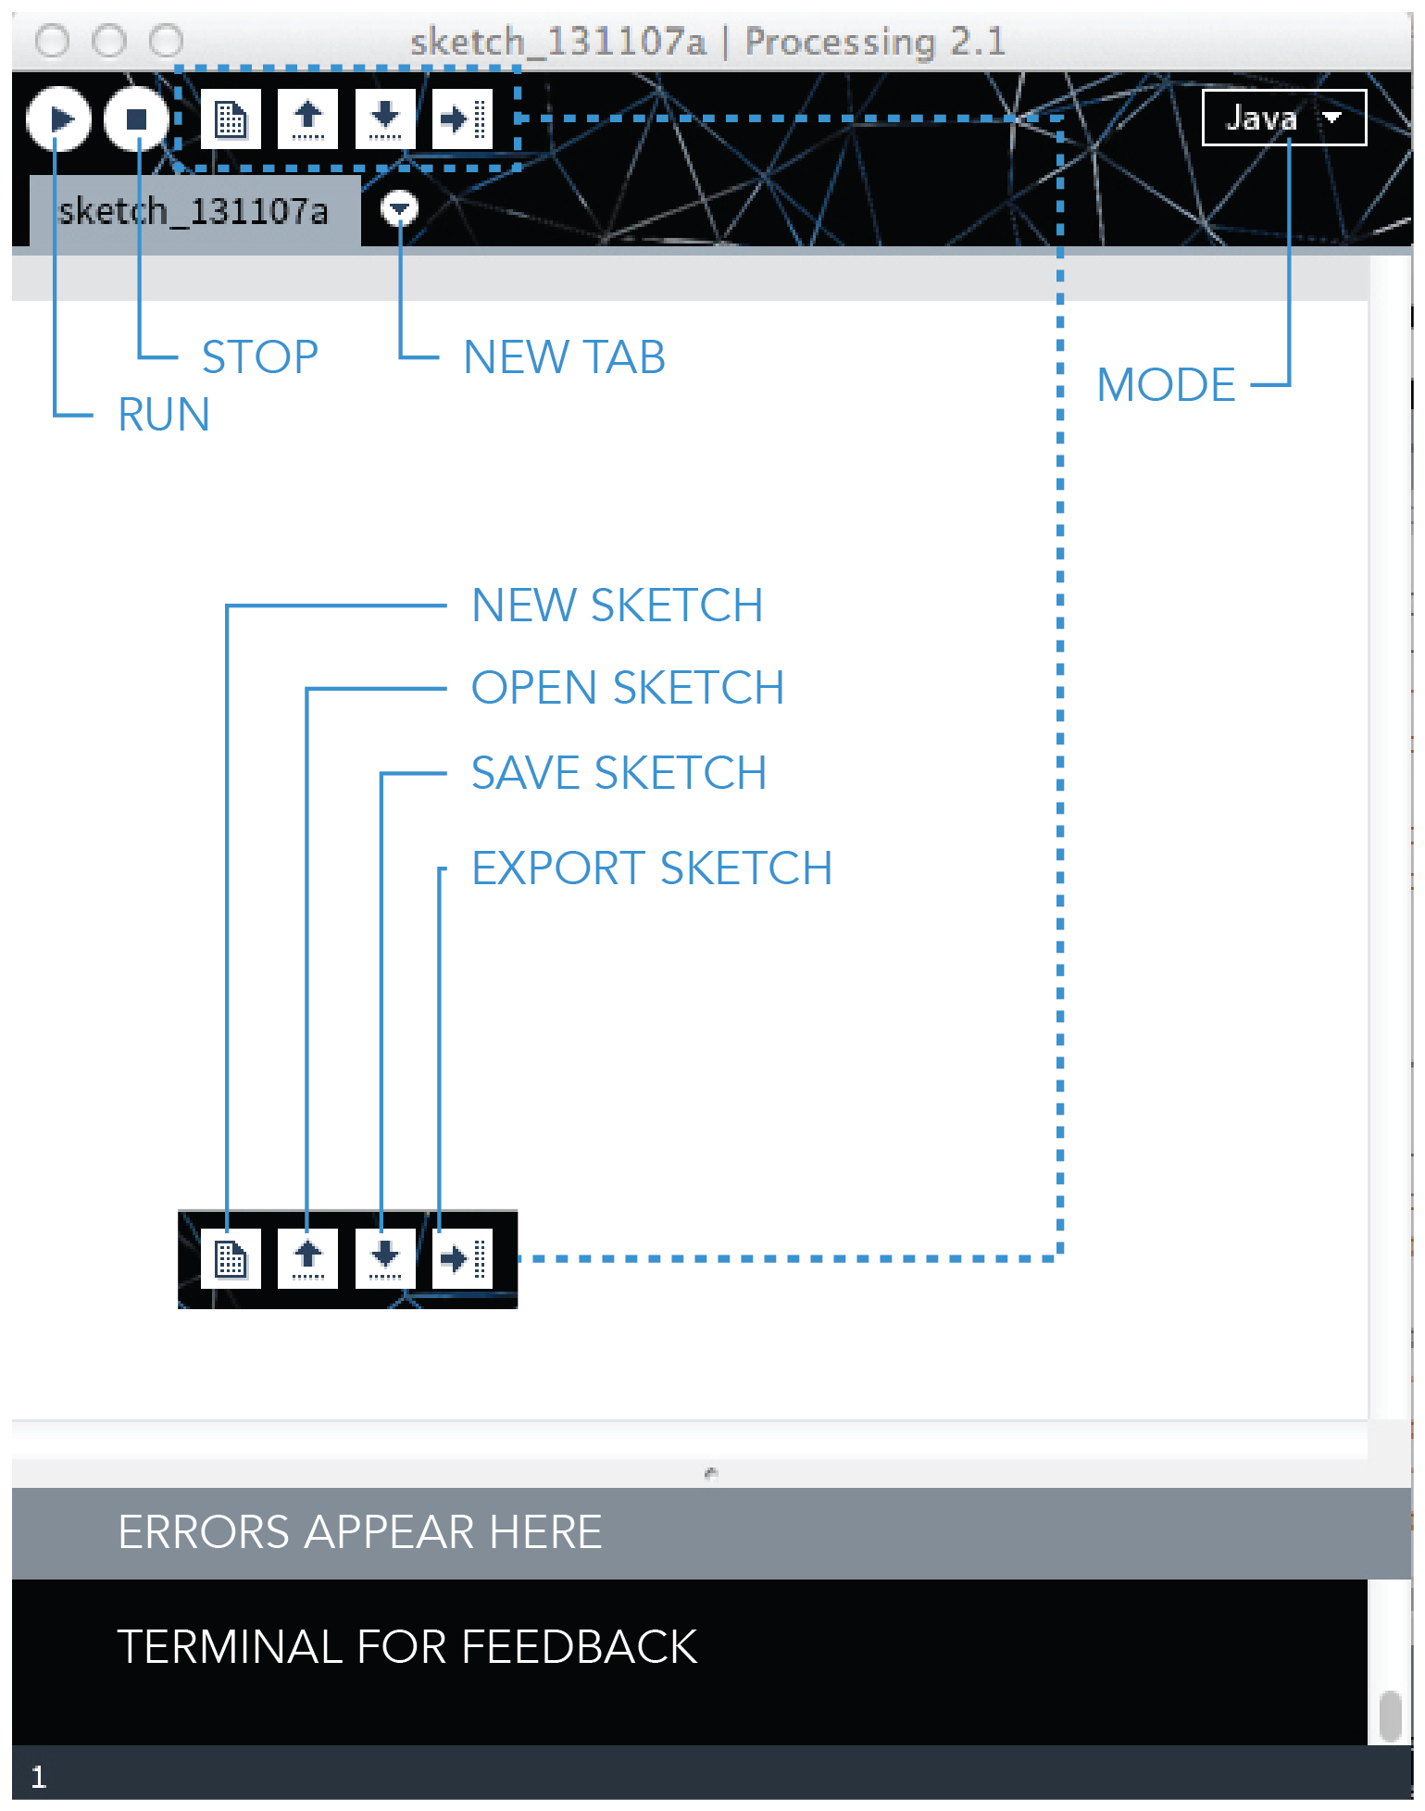
2_interface
INTERFACE
MENUS
Handy Options:
PROCESSING/PREF.
FILE/SKETCHBOOK
FILE/SAMPLES
EDIT/FORMAT
EDIT/COMMENT
SKETCH/
IMPORT LIBRARY
TOOLS/CREATE FONT
TOOLS/COLOR SEL…

Slide 26
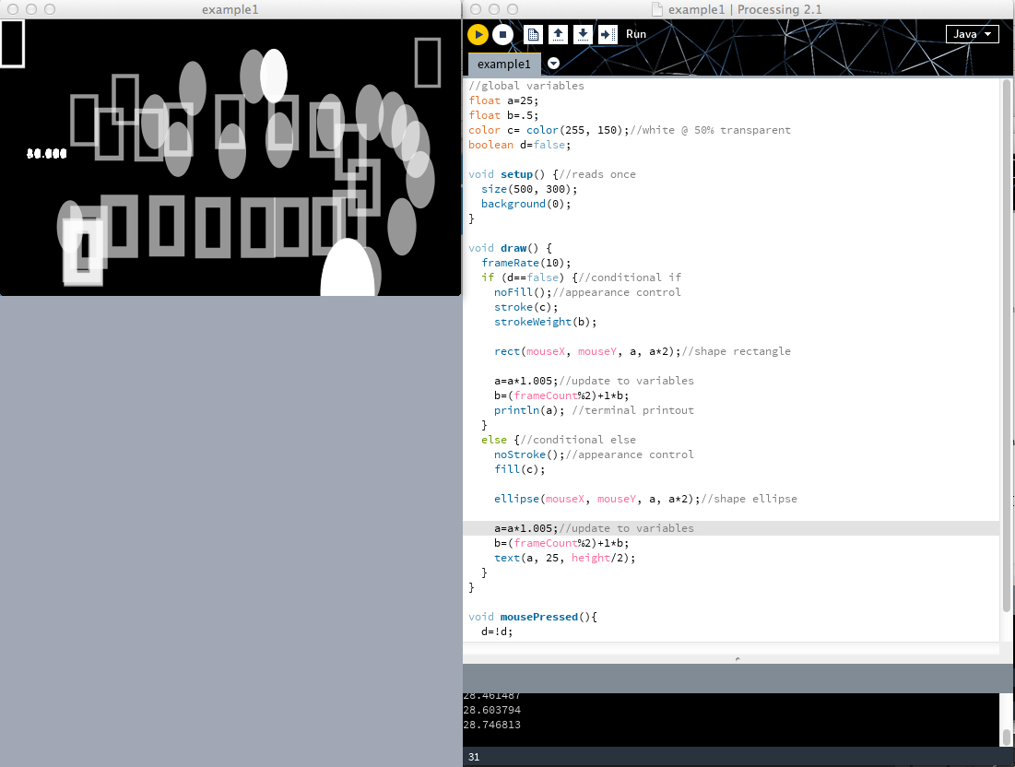
2_windows, frames
PDE/APP
Code input
Application output
CODE SAMPLE1
Size/background (static ex.)
STATIC/DYNAMIC
“ + variable/println (dynamic)
“ + variable++
“ + local/global divisions
“ + redefinition, duplication

Slide 27
2_shapes
This will become the foundation for more complex
graph-types and symbolization/display choices :
point ( x, y ); point, size effected by strokeWeight() and stroke()
line ( x, y, x1, y1); line
rect ( x, y, width, height); rectangle, default upper left
ellipse ( x, y, diameter, diameter); ellipse, default centered
triangle ( x, y, x1, y1, x2, y2); triangle defined by 3 points
quad ( x, y, x1, y1, x2, y2, x3, y3); quadrilateral defined by 4 points
arc ( x, y, diameter, diameter, start radians, stop radians, mode); an arc defined by center, diameter, start & stop angles, and edge modes
CODE SAMPLE2
Point
Line
Rectangle
Ellipse
Triangle
Quad
Arc (& radians)
shapeMode(VALUE)

Slide 28
2_display
This will become the foundation for more complex
graph-types and symbolization/display choices :
beginShape(TYPE); point, line, image
vertex(x, y); //repeat per vertex
endShape(); allow complex forms to be drawn from point information
stroke (r, g, b, alpha); color of stroke noStroke();
strokeWeight (width in pixels); stroke thickness
fill (r, g, b, alpha); color of fill noFill();
CODE SAMPLE2b
Shape & vertices
stroke();
strokeWeight();
noStroke();
fill();
noFill();

Slide 29
2_loops/interactions
CODE SAMPLE2c
Loops
Mouse & Keyboard Interaction
These will become the foundation for reading through
data and enabling both drawing exports and user input:
if (int x=0; x=maxValue; x++){
actions to be repeated using x values;
} loops repeat specified action maxValue number of times
nested loops can allow cycling through x positions, y positions, and row or columns in a table
see also table specific functions for iteration:
for (TableRow row : table.findRows(value, column)) { }
mouseX, mouseY, pmouseX, void mousePressed(){ }, if (mousePressed == true) { } : mouse interactions are built into processing that return variables, act as if-tests, and act as functions
void keyPressed(){ }, if (keyPressed == ‘a’) { } etc.:
key interactions are built into processing that return variables, act as if-tests, and act as functions

Slide 30
2_tables-reading
Let’s make a simple, familiar graphic:
Find all the Table functions, listed on processing.org:
http://processing.org/reference/Table.html
http://processing.org/reference/javadoc/core/processing/data/Table.html
related functions are under the heading “Composite” on reference
SAMPLE3a
[311 sample: Barking Dog]
Declaring
Loading
Reading
(no rotation)

Slide 31
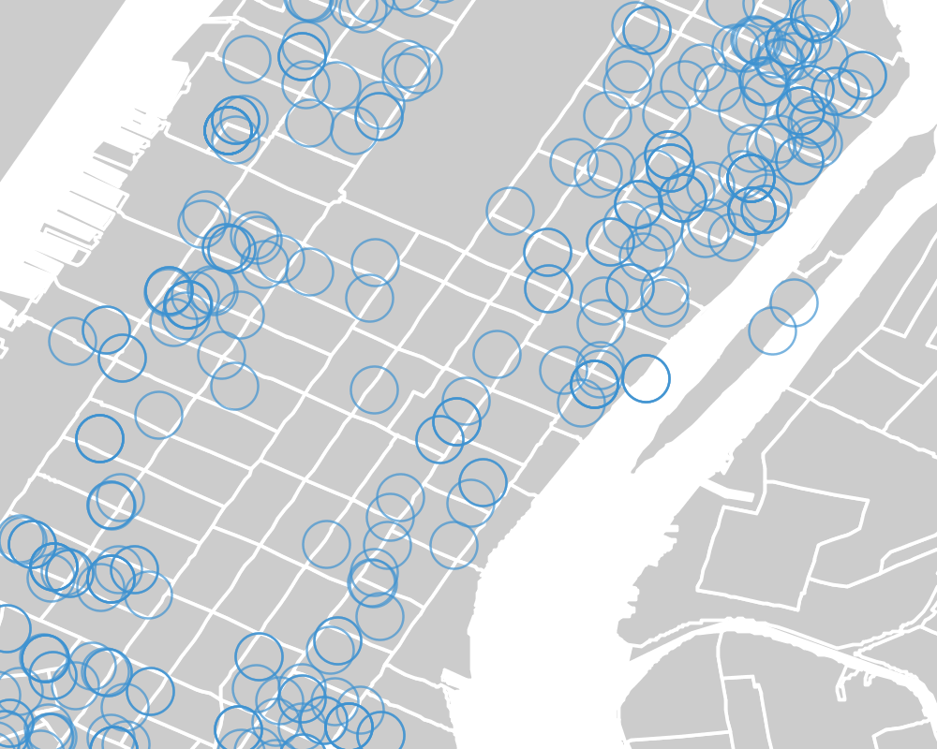
2_table-conditionals
SAMPLE3b
[311 sample: Barking Dog]
Declaring
Loading
Plotting
(no rotation)
Revise
Select (Boro)
Select (Dog)
Selection number
Re-Plotting

Slide 32
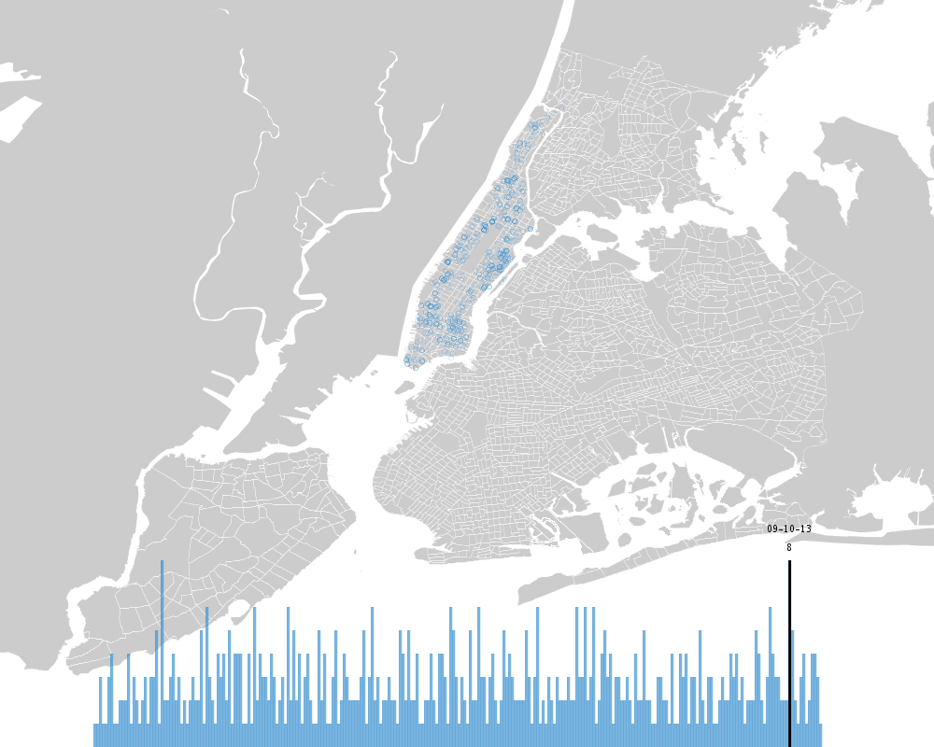
2_table-symbol by count
SAMPLE3c
[311 sample: Barking Dog]
Declaring
Loading
Plotting
(no rotation)
Revise
Select (Boro)
Select (Dog)
Selection number
Re-Plotting
Revise
Counts-Timeline

Slide 33
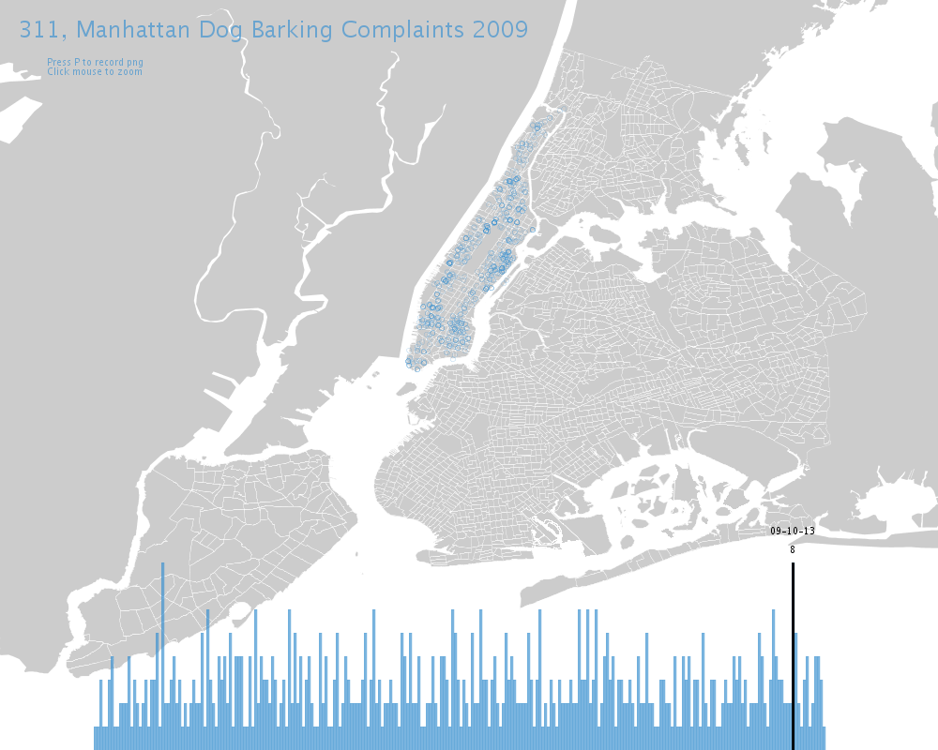
2_table-labels
SAMPLE3d
[311 sample: Barking Dog]
Declaring
Loading
Plotting
(no rotation)
Revise
Select (Boro)
Select (Dog)
Selection number
Re-Plotting
Revise
Counts-Timeline
Revise
Text labels

Slide 34
Break, breath, relax

Slide 35
3_sourcing data, forms

Slide 36
3_sourcing data, forms
1-COMPUTATIONAL STRUCTURE (is familiar!)
2-processing as plotting ENVIRONMENT
break
3-sourcing DATA, thinking DATA-REP forms
4-CODING nyc boilers together
break
5-SAME DATA, alternate views/forms

Slide 37
3_data vis forms
Look Around…
Finding Code:
https://github.com/ github- samples and demonstrations
http://stackoverflow.com/ stack overlow-questions and samples
Syllabus listed examples

Slide 38
3_sourcing data
Government/Municipal- varied types:
https://nycopendata.socrata.com/ new york city
https://data.ny.gov/ new york state
http://catalog.data.gov/dataset us national clearinghouse
http://data.un.org/ international trade/development databases
Random- varied types:
http://www.theguardian.com/news/datablog/ guardian (uk)
http://visualizing.org/data/ visualizing.org
http://developer.yahoo.com/yql/ yahoo system for web queries
Search developer/api at desired site general web queries

Slide 39
3_sourcing data
Government/Municipal- varied types:
https://nycopendata.socrata.com/ new york city
Search for Boiler Oil permits/types for NYC:
https://data.cityofnewyork.us/Housing-Development/Oil-Boilers-Detailed-Fuel-Consumption-and-Building/jfzu-yy6n
Export -> cvs, tvs, excel
Formatting -> outside Processing
Formatting -> inside Processing (see Table specific functions)
Saving & Importing
To be examined later: json, xml
See: https://github.com/shiffman/LearningProcessing/tree/master/chp18_data

Slide 40
4_plotting nyc boilers

Slide 41
4_plotting nyc boilers
1-COMPUTATIONAL STRUCTURE (is familiar!)
2-processing as plotting ENVIRONMENT
break
3-sourcing DATA, thinking DATA-REP forms
4-CODING nyc boilers together
break
5-SAME DATA, alternate views/forms

Slide 42
Break, breath, relax

Slide 43
5_alternate views/forms

Slide 44
5_alternate views/forms
1-COMPUTATIONAL STRUCTURE (is familiar!)
2-processing as plotting ENVIRONMENT
break
3-sourcing DATA, thinking DATA-REP forms
4-CODING nyc boilers together
break
5-SAME DATA, alternate views/forms

Slide 45
5_alternate views/forms
A. CODING EXERCISE_Take a table of your choosing (given/new):
Rework the symbology and/or choose new categories for plotting
Try adding labels or show additional info on interaction
Save out images or pdfs to document work, comment within code
B. PSUEDO + CODING EXERCISE_Take a data rep type of your choosing
(pie, rose, bars, area plot, etc) and data table:
1. Planning a sketch:
Draw a rough control diagram of how you would extract & calculate desired variables from a table
Sketch (by hand first if necessary) what shape primitive would make your data rep type
Annotate which calculated or table variables would be in each shape primitive
2. Constructing Pieces:
Start a sketch and mock up that form with fake variables to confirm visual/geometric coordination
Clean your data (outside or inside Processing) and makes a second sketch that extracts desired values
Use println( ) and running tests to confirm behavior
3. Combine Pieces: copy & paste, see if you can achieve initial idea, repeat steps from A.

